Slide 1

Prepared by group 13
Computer Architecture
Implementing QOS Buffer Allocation
25 November, 2024

Slide 2





Advisor
Dr. Sujay Deb
Professor (ECE, CSE)
Sneha Agarwal
PhD (SOC design, NOC architecture)
Team Members
Aayush Choudhary
Prince Kumar
Akanksh Semar
2021118
2021182
2022046

Slide 3

About Gem5
Definition:
gem5 is an open-source computer architecture simulator designed to model and analyze the behavior of hardware components like processors, memory systems, and interconnects. It allows researchers, engineers, and educators to simulate various types of systems, from simple single-core CPUs to complex multi-core setups, enabling them to test and optimize hardware designs and configurations without needing physical prototypes.
Key Features:
Customizability: Highly modular, allowing users to create and modify components like CPUs, caches, and interconnects.
ISA Support: Models multiple Instruction Set Architectures (ISAs), such as RISC-V, ARM, x86, MIPS, and SPARC.
Simulation Modes:
System Call Emulation (SE): Simulates programs running in user space.
Full System (FS): Simulates entire systems, including the OS and hardware.
Design Space Exploration: Helps in evaluating different hardware configurations to find optimal solutions.

Slide 4
About Gem5
Advantages:
Open-source and highly customizable.
Supports multiple ISAs (Instruction Set Architectures) like ARM, RISC-V, x86, SPARC, MIPS.
Useful for design space exploration, performance evaluation, and education.
Applications:
Architecture Research: Test and optimize hardware designs like processors, memory, and interconnects.
Compiler and OS Development: Debug and evaluate compilers and operating systems in a simulated environment.
Hardware-Software Co-Design: Analyze and improve software performance on specific hardware configurations.

Slide 5
About Gem5
Features:
ISA Support: Models a wide range of ISAs.
Modularity: Users can add new models or replace existing ones using C++.
Simulation Modes:
Full System (FS): Simulates the entire system, including hardware and OS.
System Call Emulation (SE): Simulates user-space programs.
Detailed Memory Hierarchies: Includes private and shared caches, DRAM models.
Interconnects: Models networks-on-chip (NoCs) and interconnections.

Slide 6
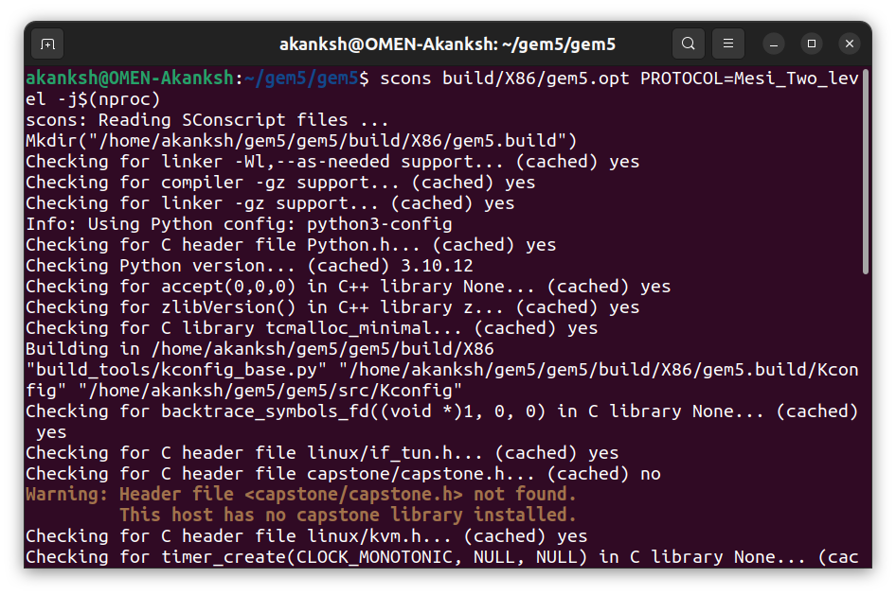
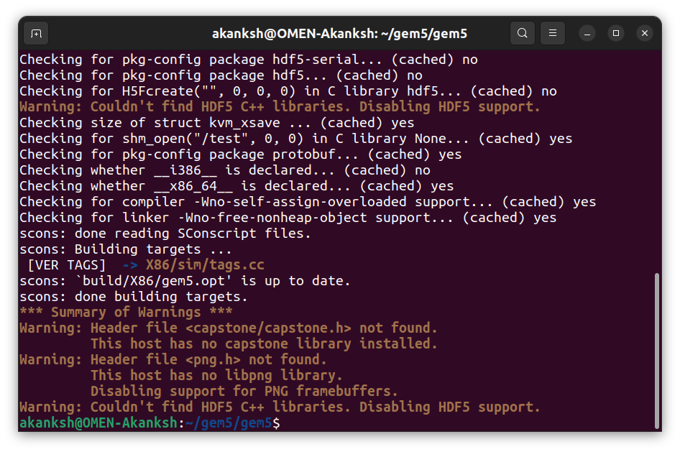
Building Gem5
Installing Gem5:
Clone the gem5 repository from Gem5 using “git clone https://github.com/gem5/gem5.git”
Install prerequisites like Python, pydot, scons, m5, six, matplotlib, gcc/g++, make, cmake, wget, git etc.
Using X86 and Mesi_Two_Level Protocol (as required in the project).
Build gem5 using: “scons build/X86/gem5.opt PROTOCOL=Mesi_Two_Level -j($nproc)”
scons: Runs the SCons build system, which gem5 uses to compile its source code.
gem5.opt: Optimized version of the simulator (recommended for running simulations).
gem5.debug: Debug version (useful for development and debugging).
-j$(nproc) flag instructs scons to spawn as many parallel jobs as total CPU cores for faster compilation.

Slide 7
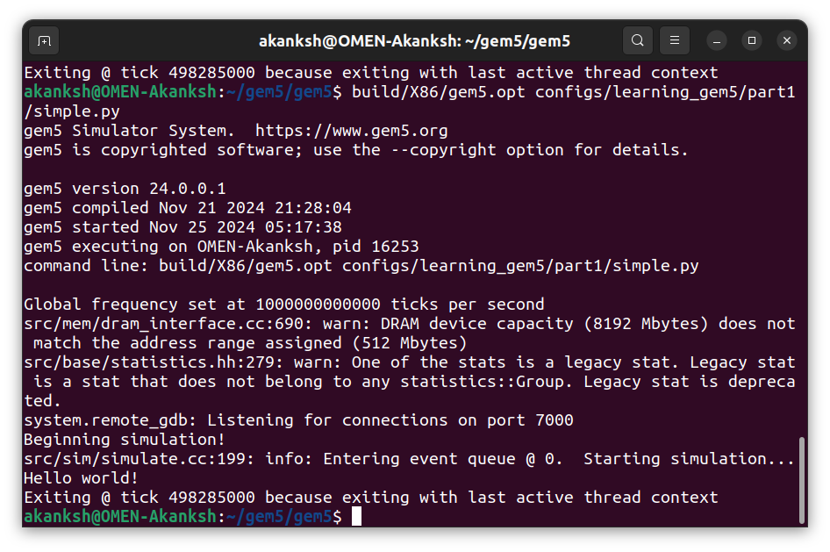
Building Gem5
Running Gem5:
Configuration Script: “/configs/learning_gem5/part1/simple.py”
This is a pre-built script for syscall emulation mode that handles basic system configuration.
Hello World Binary: “tests/test-progs/hello/bin/x86/linux/hello” is a Pre-compiled binary for x86 Simple "Hello World" program.
What's Happening Behind the Scenes:
Gem5 loads the system configuration from simple.py
Creates a simple CPU with memory system
Loads the hello binary into simulated memory
Executes the program
Outputs statistics and results

Slide 8
Building Gem5
Analysing m5out:
1. config.ini:
Contains the configuration of the simulated system.
Lists all SimObjects and their parameters.
Useful for verifying the system's architecture, such as CPU type, memory hierarchy, and cache configuration.
2. config.json:
JSON version of the config.ini file.
Easier to parse programmatically for automated analysis or debugging.
3. stats.txt:
Contains detailed statistics from the simulation.
Includes information like IPC (instructions per cycle), cache hits/misses, memory latency, branch prediction accuracy, etc.
Crucial for performance analysis.
4. config.dot:
A graphical representation of the system configuration.
Shows the hierarchy of SimObjects in the simulated system (e.g., CPUs, caches, memory).
Useful for understanding how components are connected.
5. config.system.ruby.dot:
Visualizes the topology of the Ruby memory system.
Shows how components like caches (L1, L2), memory controllers, and directory controllers are connected via interconnects (e.g., NoC or buses).
Useful for understanding and debugging the memory system's design.

Slide 9
About Project:
Implementing QOS Buffer Allocation
Efficient resource management is crucial for modern multi-core systems. This project focuses on enhancing an 8x8 Network-on-Chip (NoC) with private L1 caches, shared L2 caches, and dynamic buffer allocation at memory controllers using Gem5 Garnet.
By analyzing real-time traffic patterns, memory controllers adjust buffer allocations every 100ms based on CPU request histories. A Python script computes optimal ratios, ensuring fair resource distribution and improved Quality of Service (QoS).
This dynamic approach optimizes system performance, reduces latency, and demonstrates scalable communication for future multi-core architectures.

Slide 10

Project Objectives
Analysis Phase
Design an 8x8 Network-on-Chip (NoC) architecture:
- Equip each core with private L1 caches and 2 shared L2 caches.
- Keep default parameters for routing protocol, buffers, virtual channels and cache coherence policy (MESI).
Identify the role of memory controllers in handling request packets, including:
- CPU ID tracking (request origin).
- Timestamp logging (reception time).
Evaluate the need for dynamic buffer allocation to optimize latency, throughput, and Quality of Service (QoS).

Slide 11

Project Objectives
Key Features:
Real-Time History Tracking:
-Maintain a history of request packets received by each of the two memory controllers in 100ms intervals.
Dynamic Ratio Adjustment:
-Use a Python script to compute 64 buffer allocation ratios for the CPUs based on request patterns and timestamps.
QoS Optimization:
-Dynamically enforce buffer restrictions for each CPU according to the computed ratios, ensuring fair resource distribution.

Slide 12

Project Objectives
Implementation Plan
Build the 8x8 NoC Network:
-Configure private L1 and shared L2 caches in Gem5 Garnet.
Integrate History Tracking:
-Log CPU IDs and timestamps at memory controllers.
Python Script Execution:
-Trigger the script every 100ms to calculate buffer allocation ratios.
Modify Buffer Allocation:
-Adjust memory controller buffers dynamically during runtime based on the script output.
Test and Optimize:
-Validate the implementation under various workloads and measure the impact on QoS and system performance.

Slide 13

Methodology
Designing the NoC Architecture:
Create an 8x8 NoC with private L1 caches and shared L2 caches using Gem5 Garnet.
Configure default parameters for routing protocol, buffers, virtual channels, and cache coherence policy.
Implementing Dynamic Buffer Allocation:
Maintain a history log of CPU IDs and timestamps at the memory controllers for every 100ms.
Develop a Python script to compute buffer allocation ratios for 64 CPUs based on this history.
Testing and Refinement:
Dynamically adjust memory controller buffers during runtime based on the computed ratios.
Evaluate the system under diverse workloads to analyze QoS improvements and scalability.

Slide 14

Expected Outcomes
Dynamic Buffer Management:
Buffers are allocated dynamically based on real-time traffic analysis.
Ensures efficient utilization of limited memory controller resources.
Improved Quality of Service (QoS):
Reduces latency for high-priority and frequent requests.
Balances resource allocation to prevent bottlenecks and starvation.
Scalable and Flexible Architecture:
Demonstrates compatibility with larger NoC systems and diverse workloads.
Provides a foundation for future enhancements like ML-based QoS prediction.

Slide 15
Current Progress
Base System Configuration:
Created a system with 64 CPUs (8x8 mesh)
Set up clock domain at 1GHz
Configured 8GB system memory
Using TimingSimpleCPU model
Cache Hierarchy:
Created L1 Cache Controllers (64 controllers, one per CPU)
Set up L2 Cache Controllers (2 shared L2 caches)
Configured Ruby Directory Controllers (2 controllers)
Added necessary cache parameters:
RubyCache objects for L1 I/D caches
Set cache sizes and associativity
Configured prefetchers
Network Topology:
Implemented 8x8 Mesh_XY topology
Set up XY routing with weighted links
East/West links (weight=1)
North/South links (weight=2)
Configured link and router latencies
Special handling for L2 and directory controllers at
corner routers (0 and 63)
Communication Infrastructure:
Set up MessageBuffers for cache coherence communication
Created RubySequencers for each CPU
Configured communication channels between:
L1 caches and CPUs
L1 caches and L2 caches
L2 caches and Directory controllers
Protocol Configuration:
Implementing MESI Two-Level protocol
Configured eviction policies
Set up coherence message paths

Slide 16
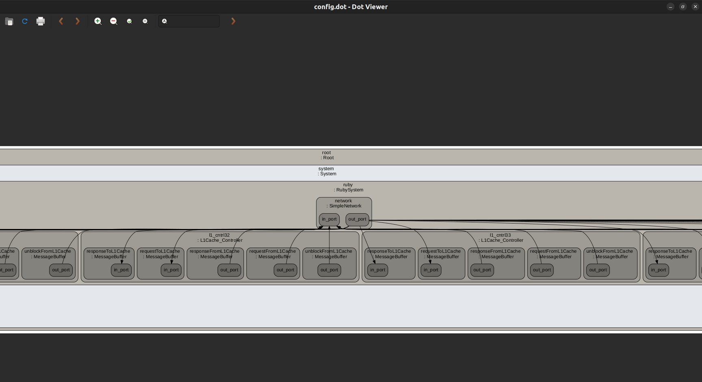
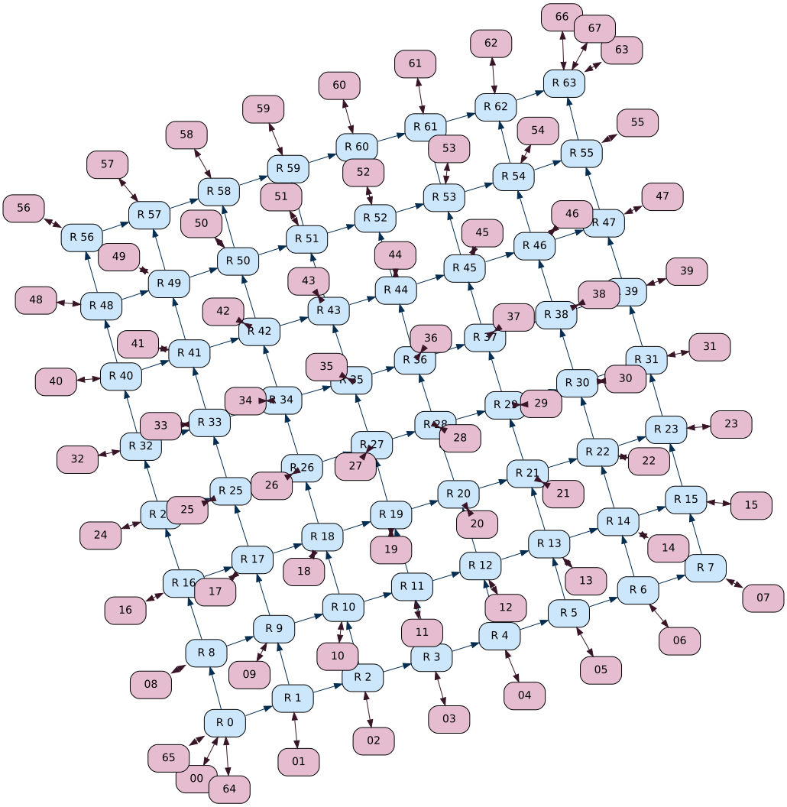
Current Progress
config.dot
config.system.ruby.dot

Slide 17
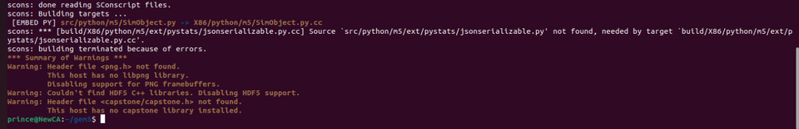
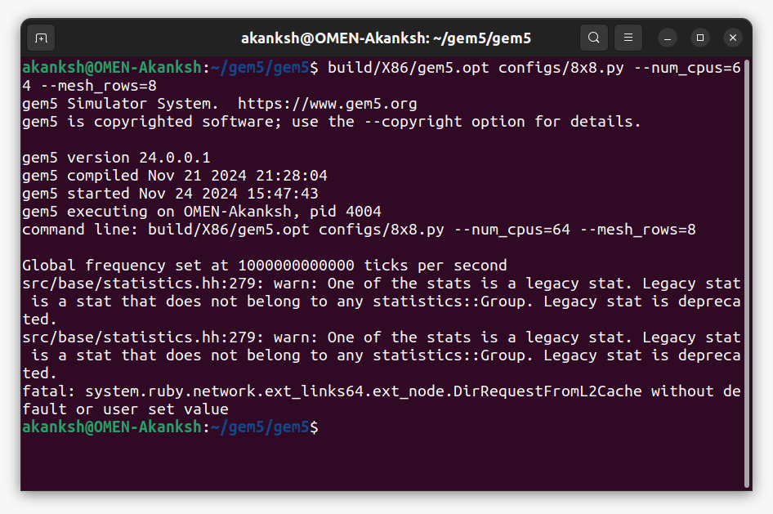
Problem Faced and Resolutions
SConscript File Update Issues:
Initially, while copying files from the gem5 development bootcamp, we modified the SConscript file as per the older repository version. However, due to updates in the gem5 repository, this caused multiple compatibility issues and we were unable to build gem5 after doing required changes in MeshXY.py. After consulting with our mentor, we reverted unnecessary changes and updated the SConscript file as per the requirement, resolving the issue successfully.
Data Packet Transmission Error:
After resolving the SConscript issue, we encountered a problem in correctly fixing the number of data packets being sent to the CPU. This required extensive debugging to ensure proper packet handling in the simulation.
DirRequestFromL2Cache Error:
Currently, we are facing an issue where, even after adding the required code for DirRequestFromL2Cache in 8x8.py, the same error persists. We are working on identifying the root cause and addressing this problem.

Slide 18

Future Scope and Resources Utilized
Future Scope
Enhanced Scheduling Algorithms: Explore advanced policies like ML-based QoS prediction.
Scalability Testing: Analyze performance with larger CPU clusters and memory controllers.
Integration with Other Gem5 Features: Combine with cache coherence protocols for end-to-end QoS solutions.
Resources Used
Gem5 Documentation
Gem5 Bootcamp 2022
Gem5 Bootcamp 2024
Gem5 On-Chip Network

Slide 19
Conclusion
This project demonstrates an efficient dynamic QoS buffer allocation system in an 8x8 NoC architecture. By analyzing real-time traffic patterns and adjusting memory controller buffers, it improves resource utilization, reduces latency, and balances workloads across 64 CPUs. The scalable design highlights its adaptability for larger networks and complex workloads, offering a significant step forward in optimizing NoC performance and resource management.

Slide 20
Thank you

